Slide 1
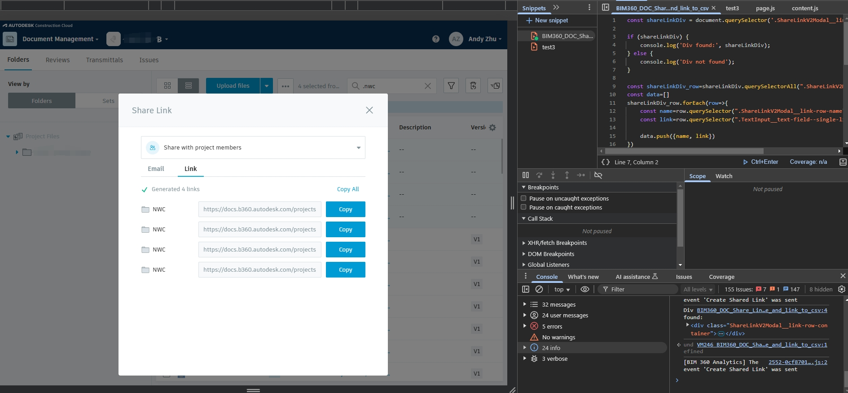
BIM360 DOC - Selected Name and Link to CSV Solution
Application No: 1300250117
This solution is designed for sharing ideas, often eliminating the need for complex buttons or plugins. A simple script can significantly reduce your workload. Specifically, it extracts file links from BIM 360 and saves them in an Excel spreadsheet. This straightforward approach streamlines the process, allowing users to efficiently organize and access project files without unnecessary tools or interfaces. By automating link extraction and storage, it saves time and effort, making it an ideal choice for managing large volumes of data in a practical, user-friendly way.

Slide 2
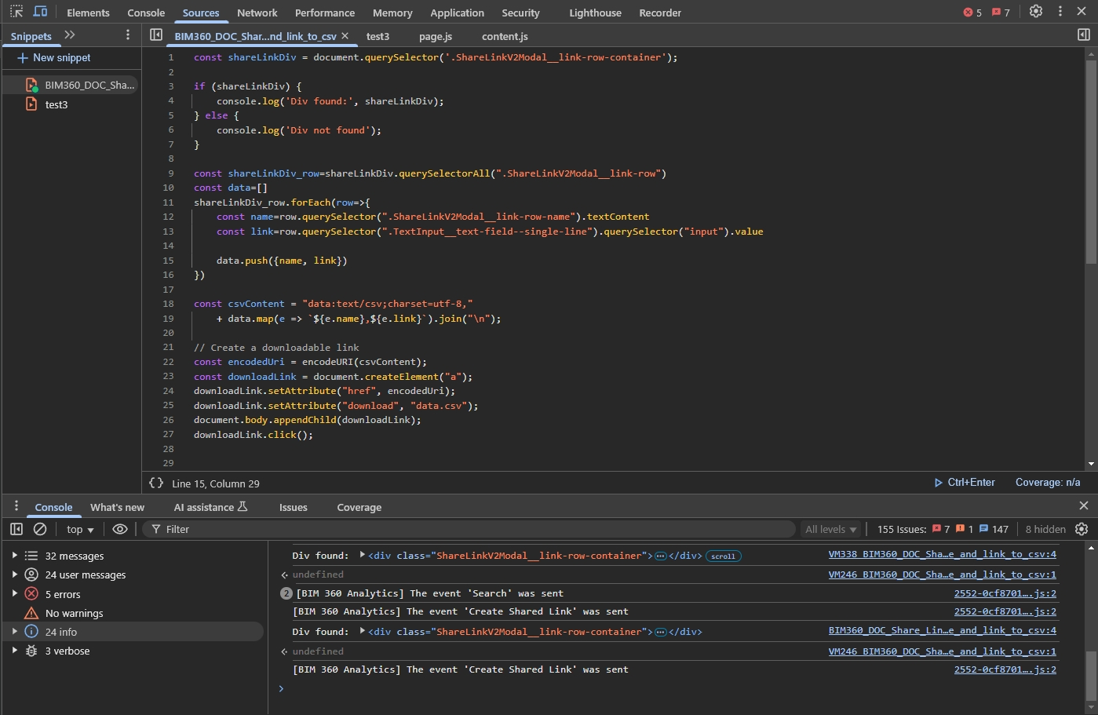
BIM360 DOC - Selected Name and Link to CSV Solution
Application No: 1300250117
Sometimes in a project, directly using code can be more flexible and efficient than relying on plugins.

